Slide 1
UNIVERSITY OF TUNIS CULTURAL DAYS · HIDE · FRIDAY, NOVEMBER 13
Paint-by-
Number Studio
1
A printable paint-by-number, generated by a machine that has never been told what a child is.
4
PRESENTED BY
Rayen Zaibi · Mohamed Habib Lousaief
A DIGITAL ARTS INSTALLATION BY
Aziz Kaouach · Thameur Oueslati · Rayen Zaibi · Faouzi Blibech

Slide 2
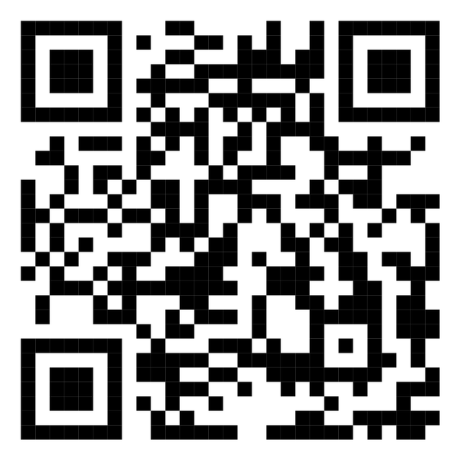
Before we start, please scan this code or open this URL:
https://paint-by-number-studio-dso1.onrender.com
Scan me
Page 2 of 16

Slide 3
The content of the presentation:
NEW
1. Key idea
2. The added value
3. The main functionality
4. What users see
5. New: gallery, painting and the 360° sculpture
6. The end-to-end pipeline
7. The technicality of the app
8. Important distinction!
9. Everything under the hood
10. Where it goes next
Click any card to jump to that part.
Page 3 of 16

Slide 4
1. Key idea:
What happens when a machine looks at a
complex piece of human history:
a monument, a face, a landscape, and
reduces it to something a child can recolor?
Page 4 of 16

Slide 5
2. The added value:
“
Reduction is violence
A 16-color quantization throws away the texture of weather, age, brushstroke, and intent.
What happens when a machine reduces history for a child?
Reduction is invitation
What is removed leaves a blank — and the blank is what asks the child to put themselves into the picture.
”
Both are true at once. The art lives in the gap between what was removed and what is added back.
Page 5 of 16

Slide 6
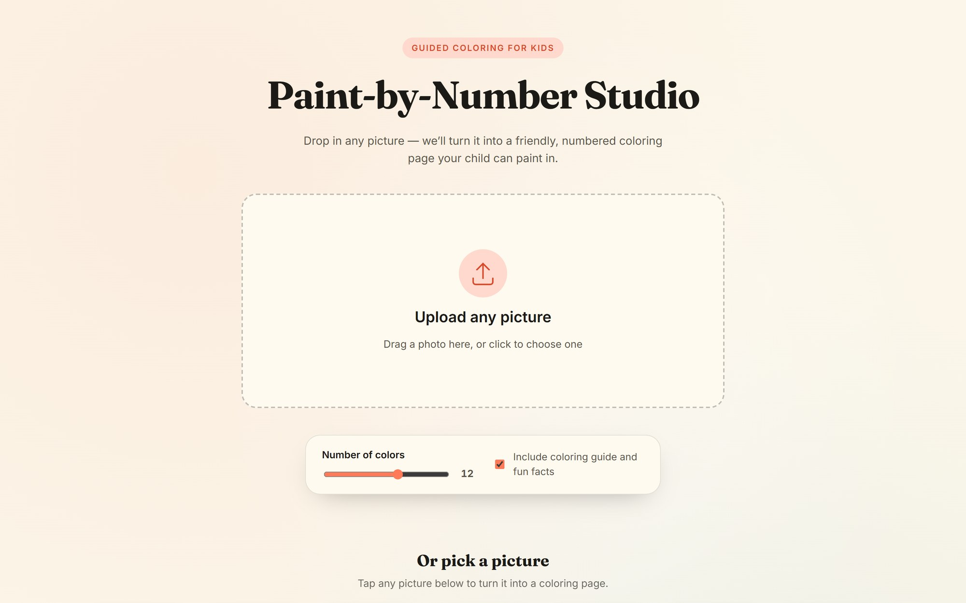
3. The main functionality:
Upload a photo, get a coloring page
paint-by-number-studio · upload
Upload any photo and get a printable paint-by-number coloring page, a written coloring guide, and a kid-friendly “Did you know?” fact card.
01 / Output
Coloring page
02 / Output
Color guide
03 / Output
Coloring guide
04 / Output
Did-you-know facts
05 / Action
Download / Print
06 / Stylesheet
A4 print-ready
07 / New
Gallery: pick a ready picture
08 / New
Paint it in the app
09 / New
360° paper sculpture
drop a photo, or pick one from the gallery
Page 6 of 16

Slide 7
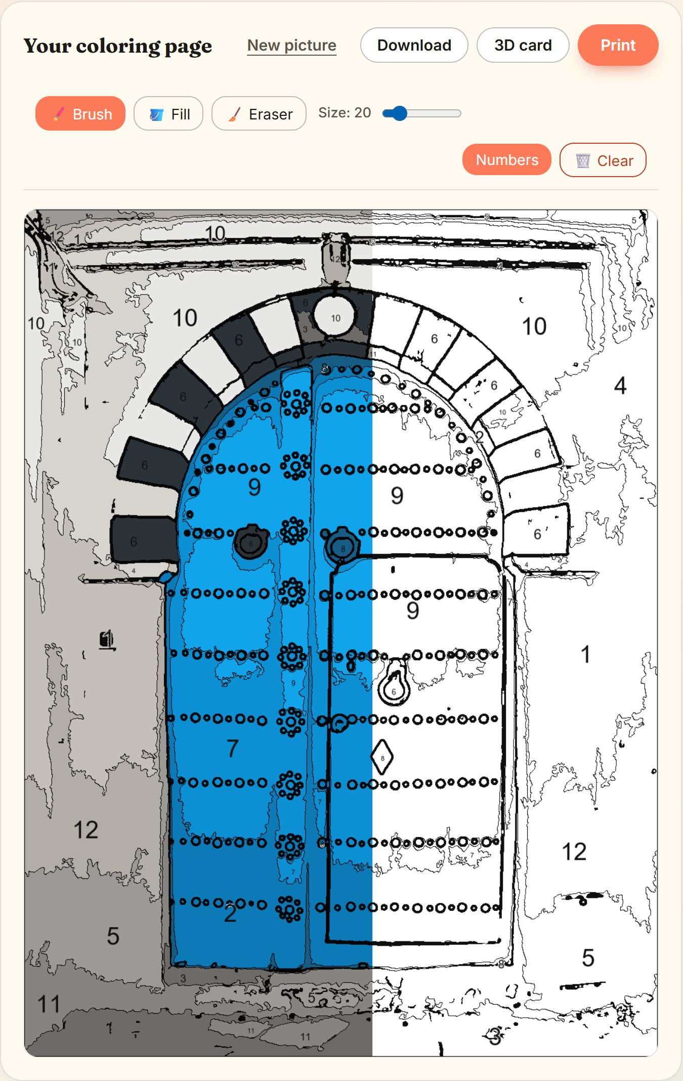
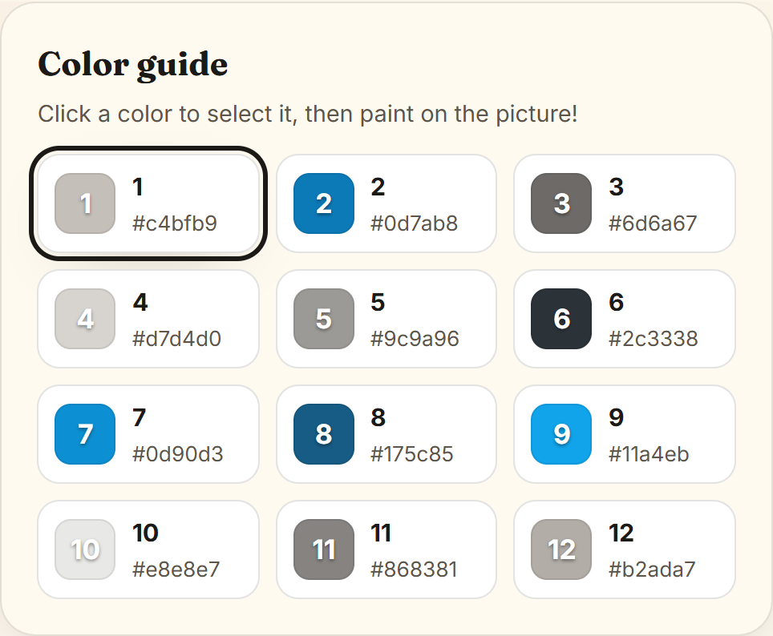
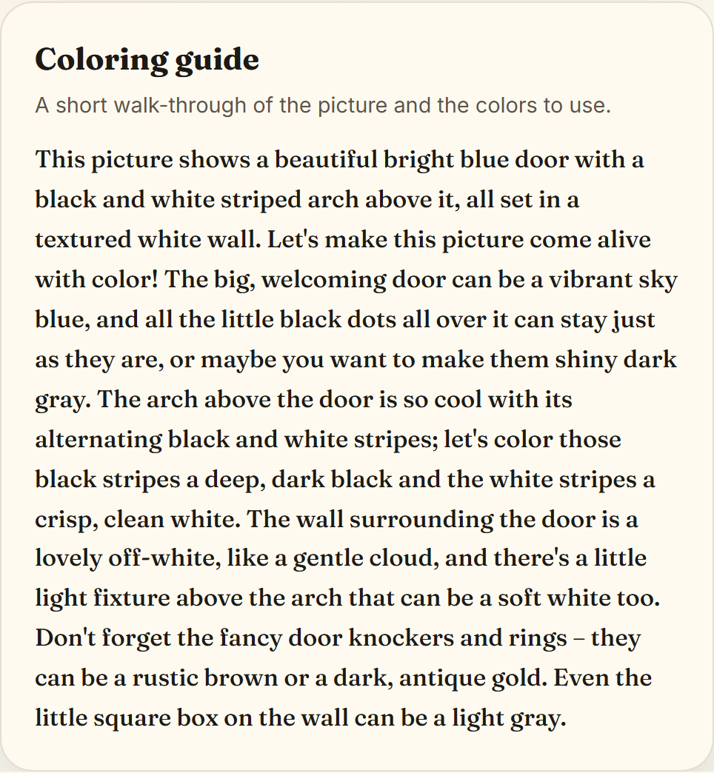
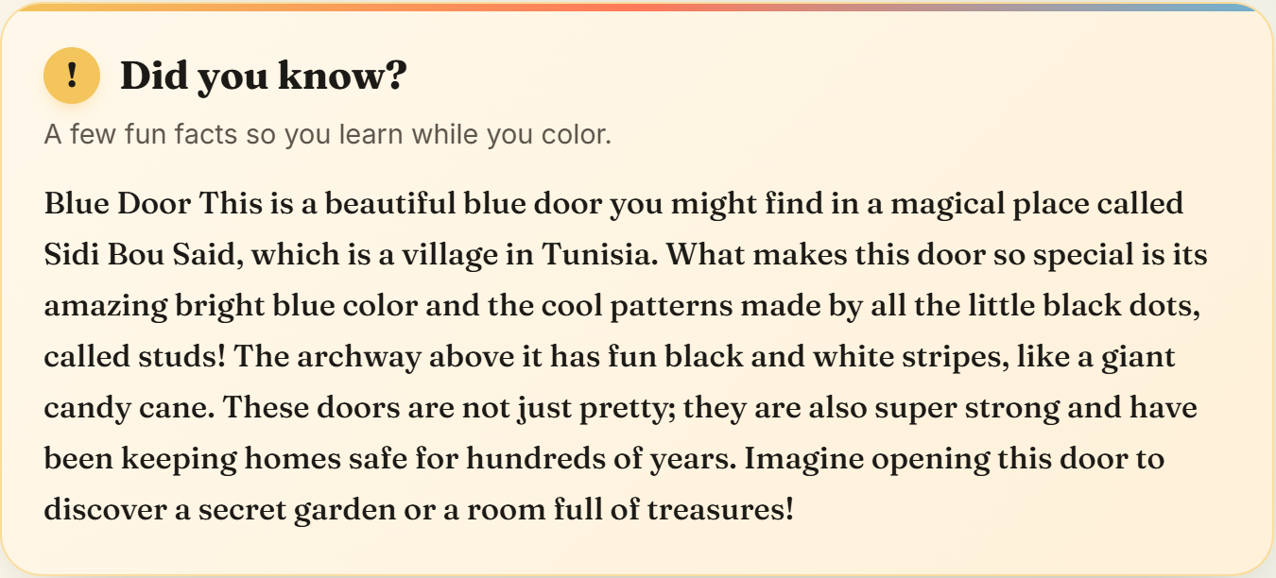
4. What users see:
SURFACE · 01
Coloring page
The page itself. Paint it in the app, download your painting, or print the numbered page on A4.
SURFACE · 02
Color guide
Legend strip — numbered swatches with hex codes, the same numbers that appear on the page.
SURFACE · 03
Coloring guide
A paragraph that names each part of the picture and suggests a color. Written by Gemini, read by a parent.
Download
Print
SURFACE · 04 · SLIDES UP
Did you know?
Kid-friendly facts about the subject. Slides up from under the page on tap.
left half painted,
right half still numbered
Page 7 of 16

Slide 8
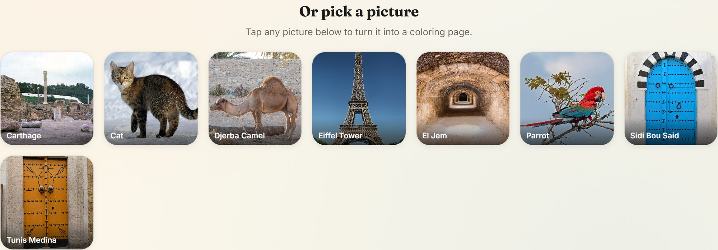
5. New:
NEW · THE GALLERY
No photo? Pick one.
New
Ready pictures from Tunisia and around the world.
Every visitor’s upload joins the wall, so the gallery grows all afternoon.
Sidi Bou Said
El Jem
Carthage
Medina of Tunis
Djerba
Page 8 of 16

Slide 9
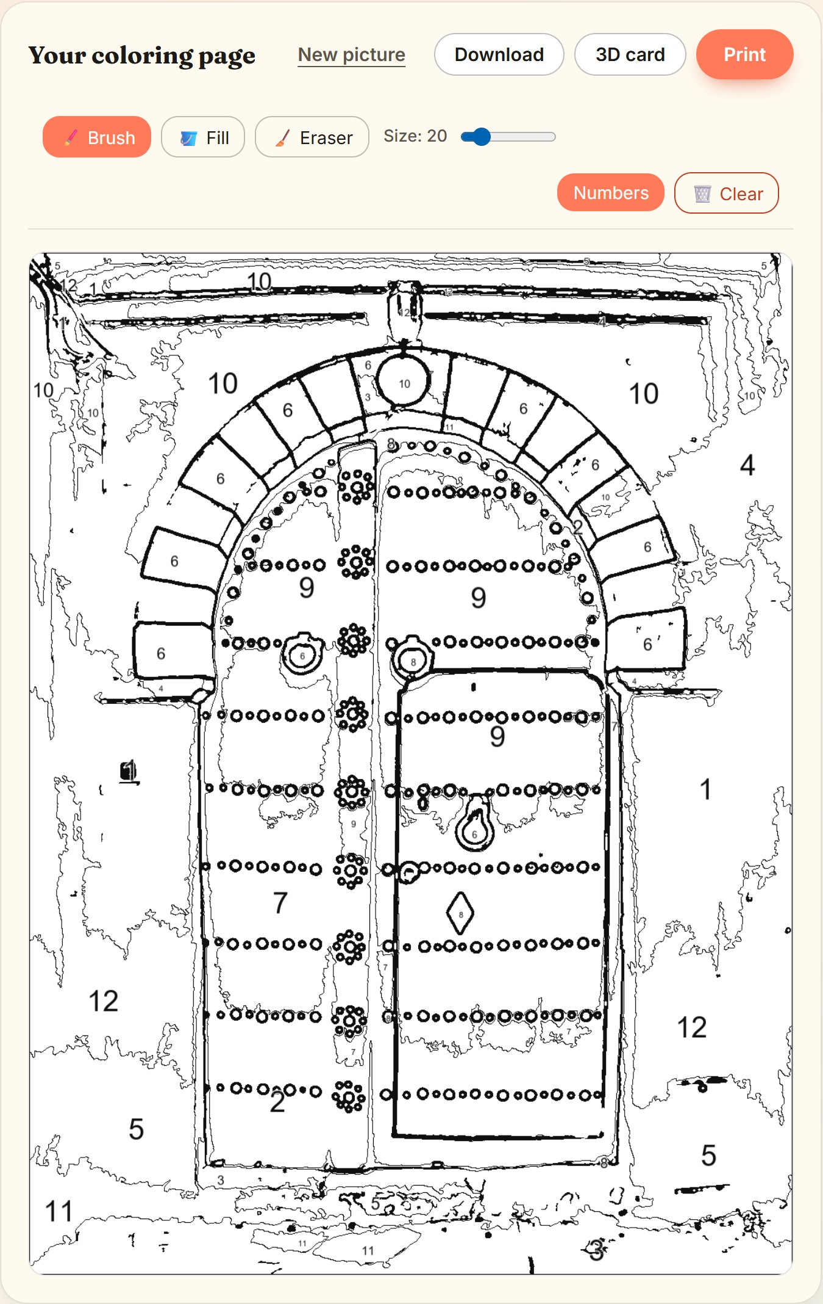
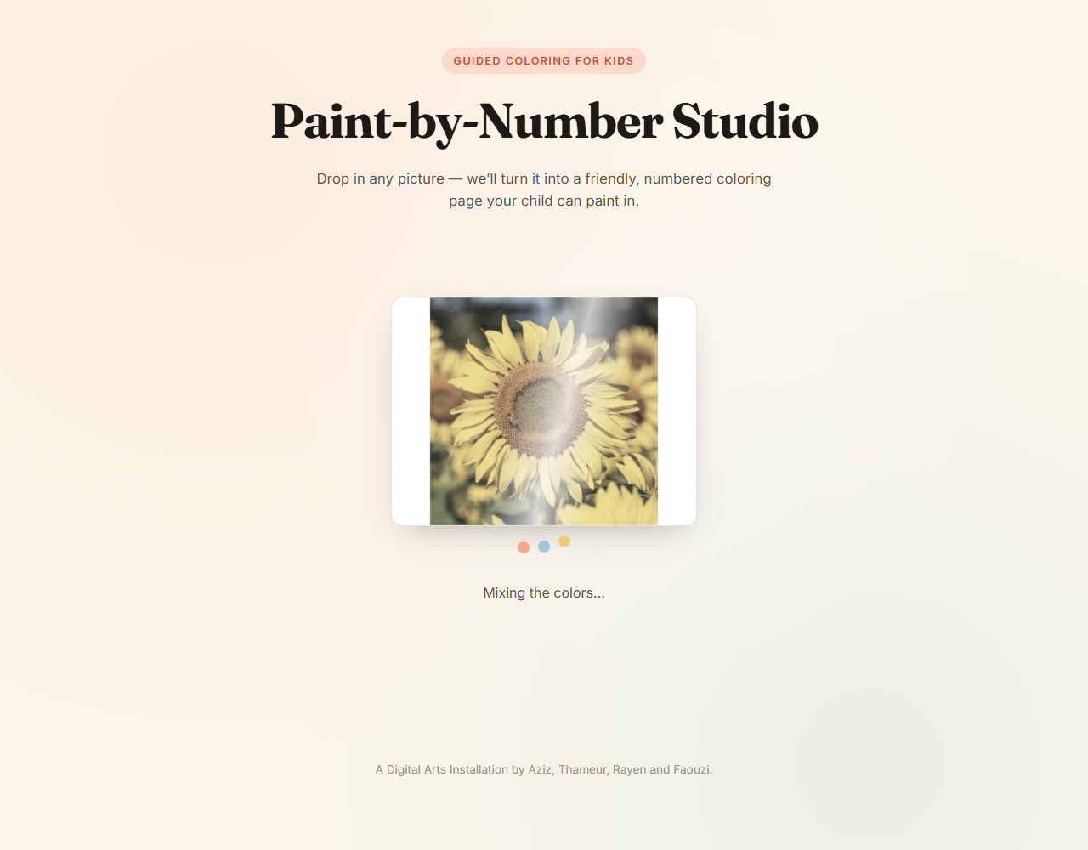
5. New:
NEW · PAINT IN THE APP
Tap, fill, done.
1
Ready in under a second.
2
Fill paints a whole region in one tap.
3
Numbers float above the paint, so they’re never lost.
0.15 s
your photo shimmers while it’s drawn
from picture to paintable page
Page 9 of 16

Slide 10
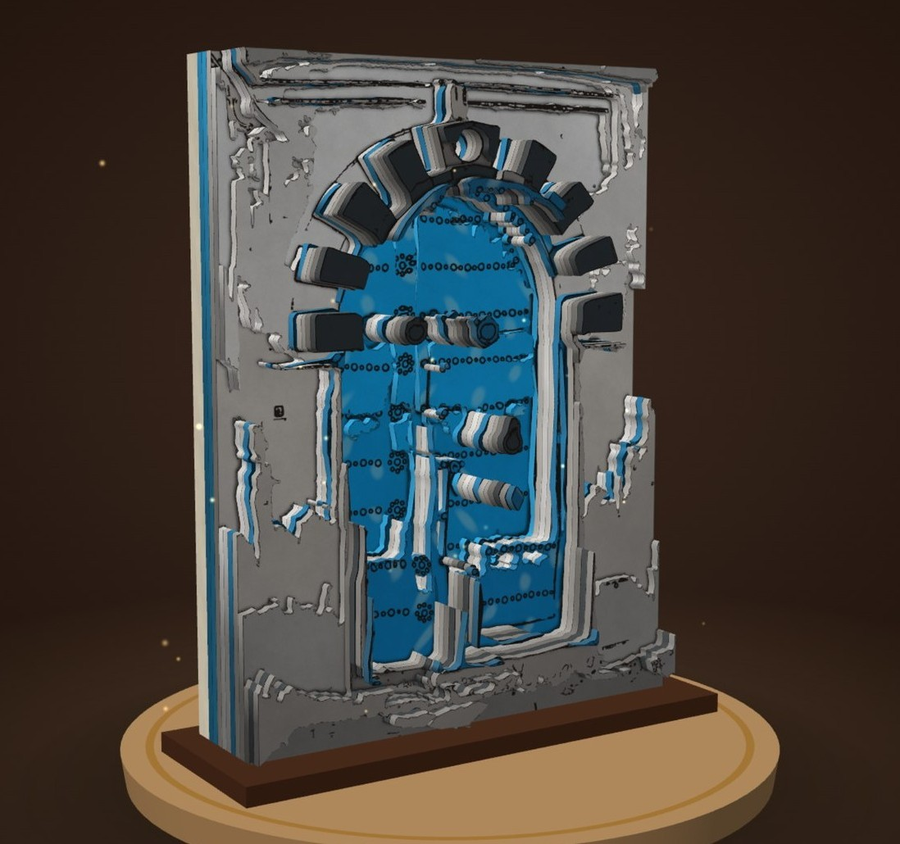
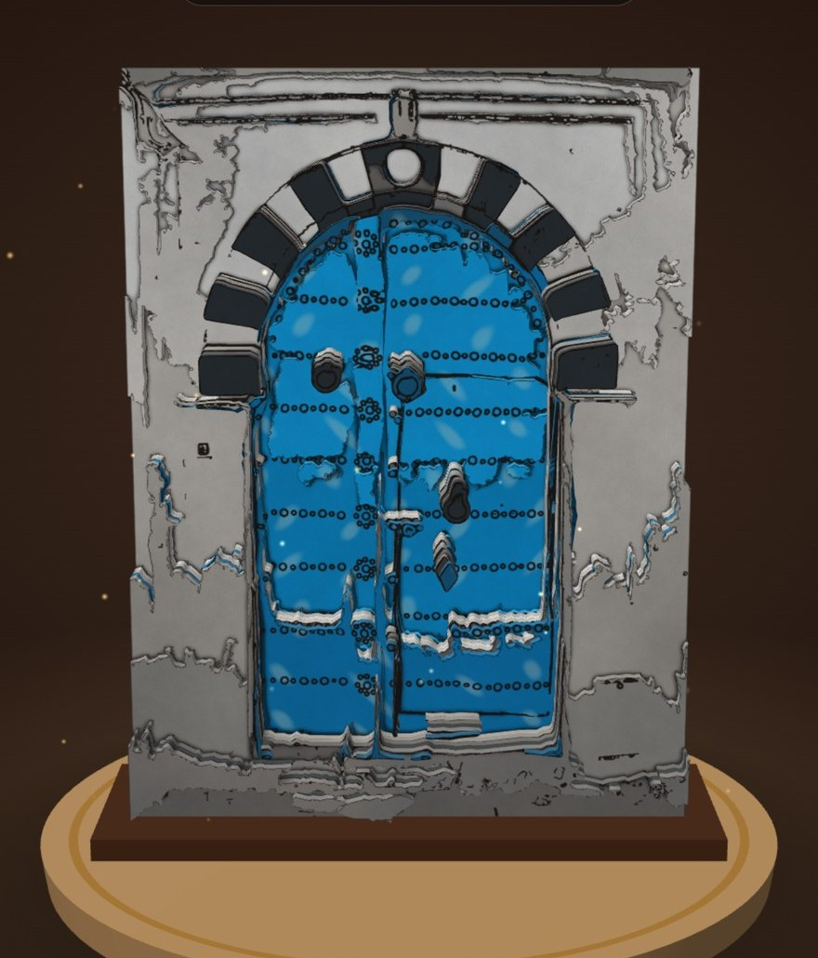
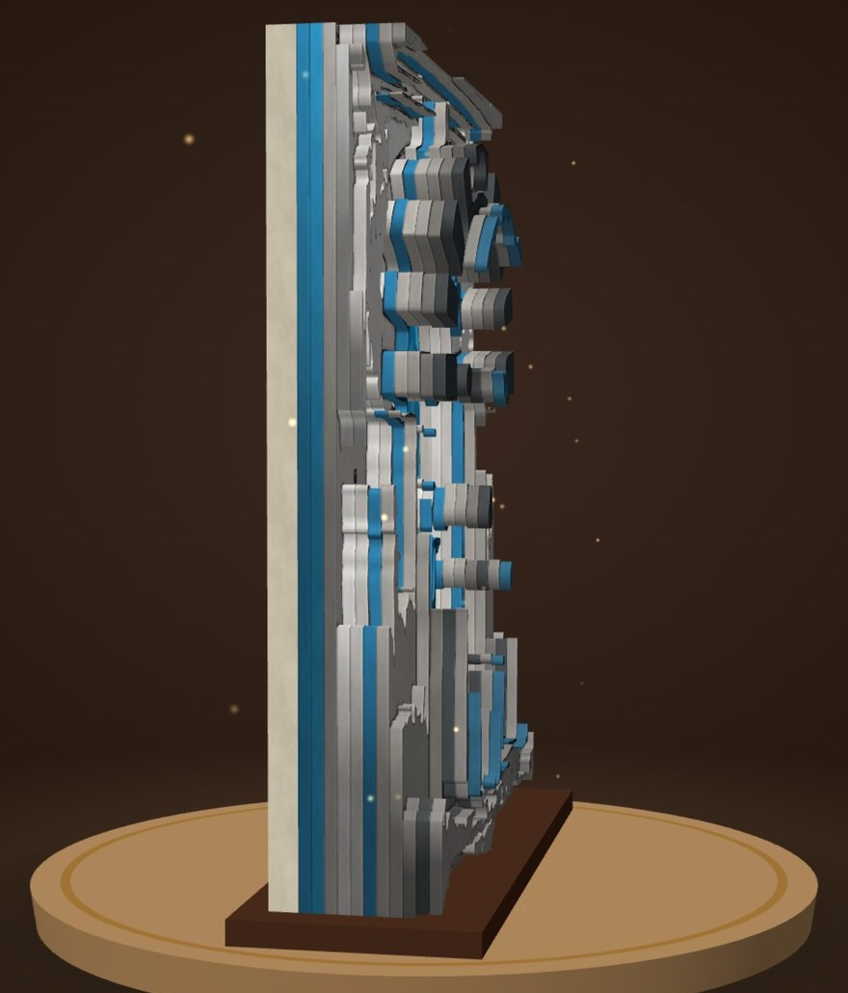
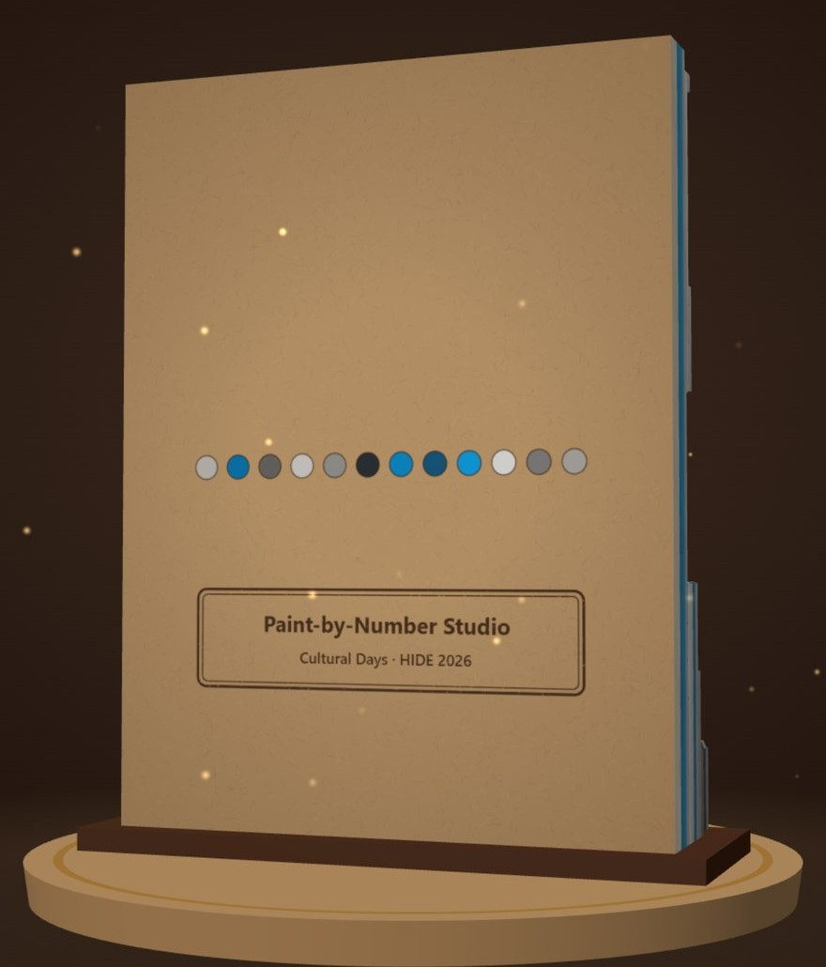
5. New:
NEW · 360° SCULPTURE
DRAG · ZOOM · SPIN
From flat page
to sculpture.
Every color you paint becomes a layer of cut card. Turn it all the way round: it has depth, edges and a back.
IT COMES ALIVE
ripples like water
sways like leaves
glows like sunlight
breathes like clouds
dark stays still
front
side
back
The machine removes. The child adds back. Now what they added stands up.
Page 10 of 16

Slide 11
6. The end-to-end pipeline:
PIPELINE · END TO END
Three things happen in parallel as soon as a photo is uploaded: two language calls and one piece of deterministic Python, then the frontend stitches everything together.
The page no longer waits for the AI: it appears first, and the guide and facts follow.
G
Gemini Flash-Lite
reads the photo, writes the coloring guide
FOLLOWS
STEP 3 · RENDER
Frontend renders
page + legend + guide + facts + Download/Print on an A4 stylesheet.
+ paint in the browser
+ 360° sculpture
STEP 1 · INPUT
Photo upload
Any JPG/PNG. Faces, monuments, landscapes — anything with structure to find.
G
Gemini Flash
writes “Did you know?” facts
FOLLOWS
PY
Local Python
builds the paint-by-number page
FIRST
Page 11 of 16

Slide 12
7. The technicality of the app:
1
2
3
4
Resize to 1400×1400
Sobel edge detection
Median + Gaussian smoothing
K-Means quantization
5
6
7
8
Connected-component labeling
Trace region borders
Overlay preserved edges
Number placement
5 minutes → under 1 second
smarter clean-up · cached gallery pages · smaller uploads
Page 12 of 16

Slide 13
8. Important distinction!
OPTION · A · REJECTED
Let an image model redraw the photo
Gemini’s image model has a free-tier limit of 0 — but the deeper problem is hallucination. The Eiffel Tower with five legs is no longer the Eiffel Tower.
We do not use AI image generation.
OPTION · B · CHOSEN
Posterize the real photo with deterministic Python
K-Means + edge overlay. Identity preserved, mathematically explainable, free to run, faithful to the source.
Posterizing the real photo keeps the coloring page faithful to the original. Redrawing would introduce hallucinations and lose identity.
Page 13 of 16

Slide 14
9. Everything under the hood:
GEOMETRY · PYTHON CORE
Py
Python
F
FastAPI
U
Uvicorn
PIL
Pillow
np
NumPy
Sp
SciPy
sk
scikit-learn
LANGUAGE · AI TEXT
G
Gemini 2.5
flash-lite · text only
FRONTEND · THE PAGE
5
HTML
vanilla
3
CSS
vanilla
JS
JavaScript
vanilla
Aa
Fraunces
+ Inter
3D · THE SCULPTURE
NEW
3
Three.js
GL
WebGL
fx
GLSL shaders
O
OrbitControls
Page 14 of 16

Slide 15
10. Where it goes next:
ALREADY SHIPPED
Cloud demo
Painting in the app
01
02
03
04
NEW
05
NEW
Multilingual guide
FR · AR translations of the coloring guide and “Did you know?” facts, generated alongside English.
QR audio narration
A QR code printed on the page that opens an audio reading of the guide for pre-readers.
Museum mode
Auto-tagged monuments. Point a camera at a building, get its coloring page on the spot.
Collective mural
A big picture split into tiles. Each visitor colors one, and the full mural is revealed at the end of the day.
Paper to screen
Color a printed page with real crayons, show it to the camera, and watch it become a 3D sculpture.
Page 15 of 16

Slide 16
CREDITS & THANKS
Thank you.
Page 16 of 16

